Slide 1
MLB Hall of Fame probability
Hayden Lamprecht

Slide 2
Research Question
Do players with higher stats get into the Hall of Fame quicker?
Dependent Variable:
Years to Hall of Fame
Independent Variables:
WAR/Season
All-Star Appearances
Notes:
Explanation on next slide

Slide 3
Explanation of variables
Years to Hall of Fame:
Difference between the year a player was inducted into the hall of fame and the year the player retired
WAR/Season:
WAR (wins above replacement) measures a player’s overall value to their team
  Taken as per season because of varying number of seasons played
All-Star Appearances:
Each season has an All-Star game which takes the top players at each position
Notes:
Further explain what WAR is and how all-star selections work

Slide 4
data
All data was pulled from BaseballReference.com
Pulled top 500 WARs of all time
Pulled complete list of Hall of Fame players
Combined data sets
Deleted players who were not yet retired and not in the Hall of Fame
Deleted players whose career began before 1933 (all-star game)
Also deleted players who do not fit current Hall of Fame qualifications
  10 years of experience and 5 years of retirement
Notes:
Further explain how data was listed and hall of fame qualifications

Slide 5
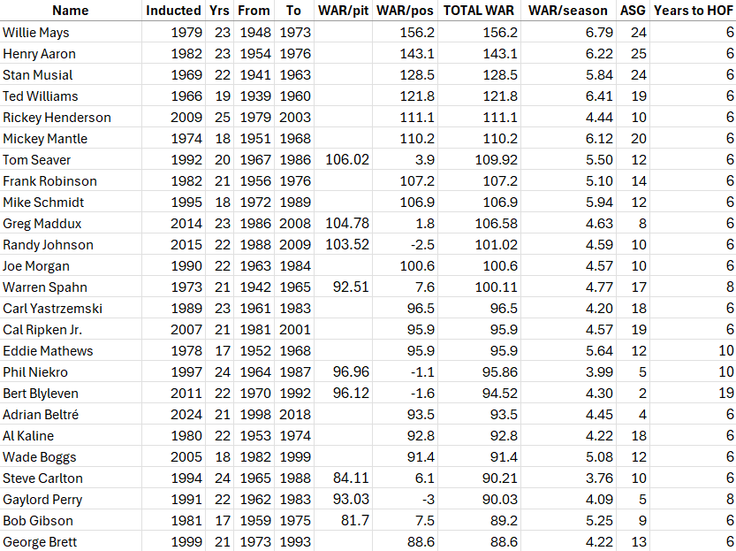
data
Added equation to calculate the years to Hall of Fame
Added equation to calculate WAR/Season

Slide 6
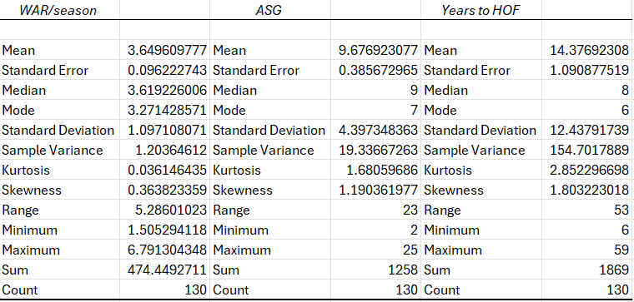
Desc stats

Slide 7
Expectations of model
Years to HOF = B₀ - B₁ WAR/Season - B₂ All-Star Appearances + e
Notes:
Explain why

Slide 8
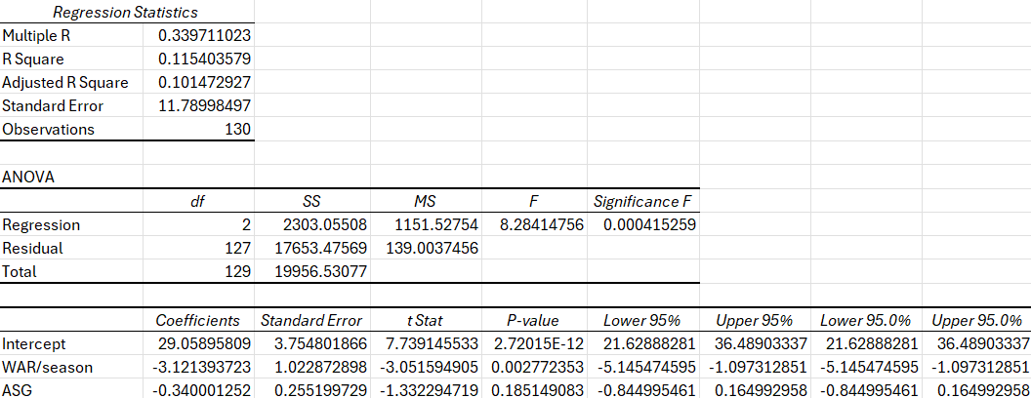
results
Notes:
Go over r squared + f stat + ind significance

Slide 9

conclusion
Model is significant (F=8.28 ; p=0.0004)
All-Star appearances is not significant
Low R Squared (10.15%)
Multicollinearity?
Solutions?

